Slide 1
PERS NAL RESUME

Slide 2
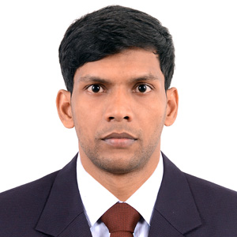
PERSONAL RESUME
HABIBUR RAHMAN
Address : Bangabandhu Sheikh Mujibur Rahman Hall, Shahajalal University of Science &
Technology, Sylhet Sadar, Sylhet 3114
Home Phone : 01518983895
Mobile : 01717451942
e-mail: habiburrh039@gmail.com, habiburrahman6239@gmail.com

Slide 3
PERSONAL RESUME
Personal Details :
Father's Name : KAMOR UDDIN
Mother's Name : HAJERA BEGUM
Date of Birth : May 3, 1998
Gender : Male
Marital Status : Unmarried
Nationality : Bangladeshi
Religion : Islam
Permanent Address : Uttar Kashipur, Ghughur Hat-5680, Phulbari, Kurigram
Current Location : Sylhet
Career Objective:
Motivated and quick-learning individual aiming to apply problem-solving abilities and creativity in challenging role. Focused on continuous growth and delivering impactful results.

Slide 4
Academic Qualification:
PERSONAL RESUME
2022
Exam Title: Bachelor of Science (BSc)
Concentration/Major: Biochemistry and Molecular Biology
Institute: Shahjalal University of Science & Technology
Result: 3.**
Duration: 4 Years
2018
Exam Title: HSC
Concentration/Major: Science
Institute: Nageswari College
Result: 5.00
Duration: 2 Years
2016
Exam Title: SSC
Concentration/Major: Science
Institute: Anantapur Adarsha High School
Result: 5.00
Duration: 2 Years.

Slide 5
PERSONAL RESUME
SKILL 01
SKILL 02
SKILL 03
Computer Programming
Knowledge
Project Management
MS Word/ Excel/ PowerPoint/
OneNote

Slide 6
THANK YOU

